Slide 1


Lori Favata, Executive Program Director – Community Solutions
Jennifer Myers, Director – Unlimited Potential
July 1, 2021

Slide 2



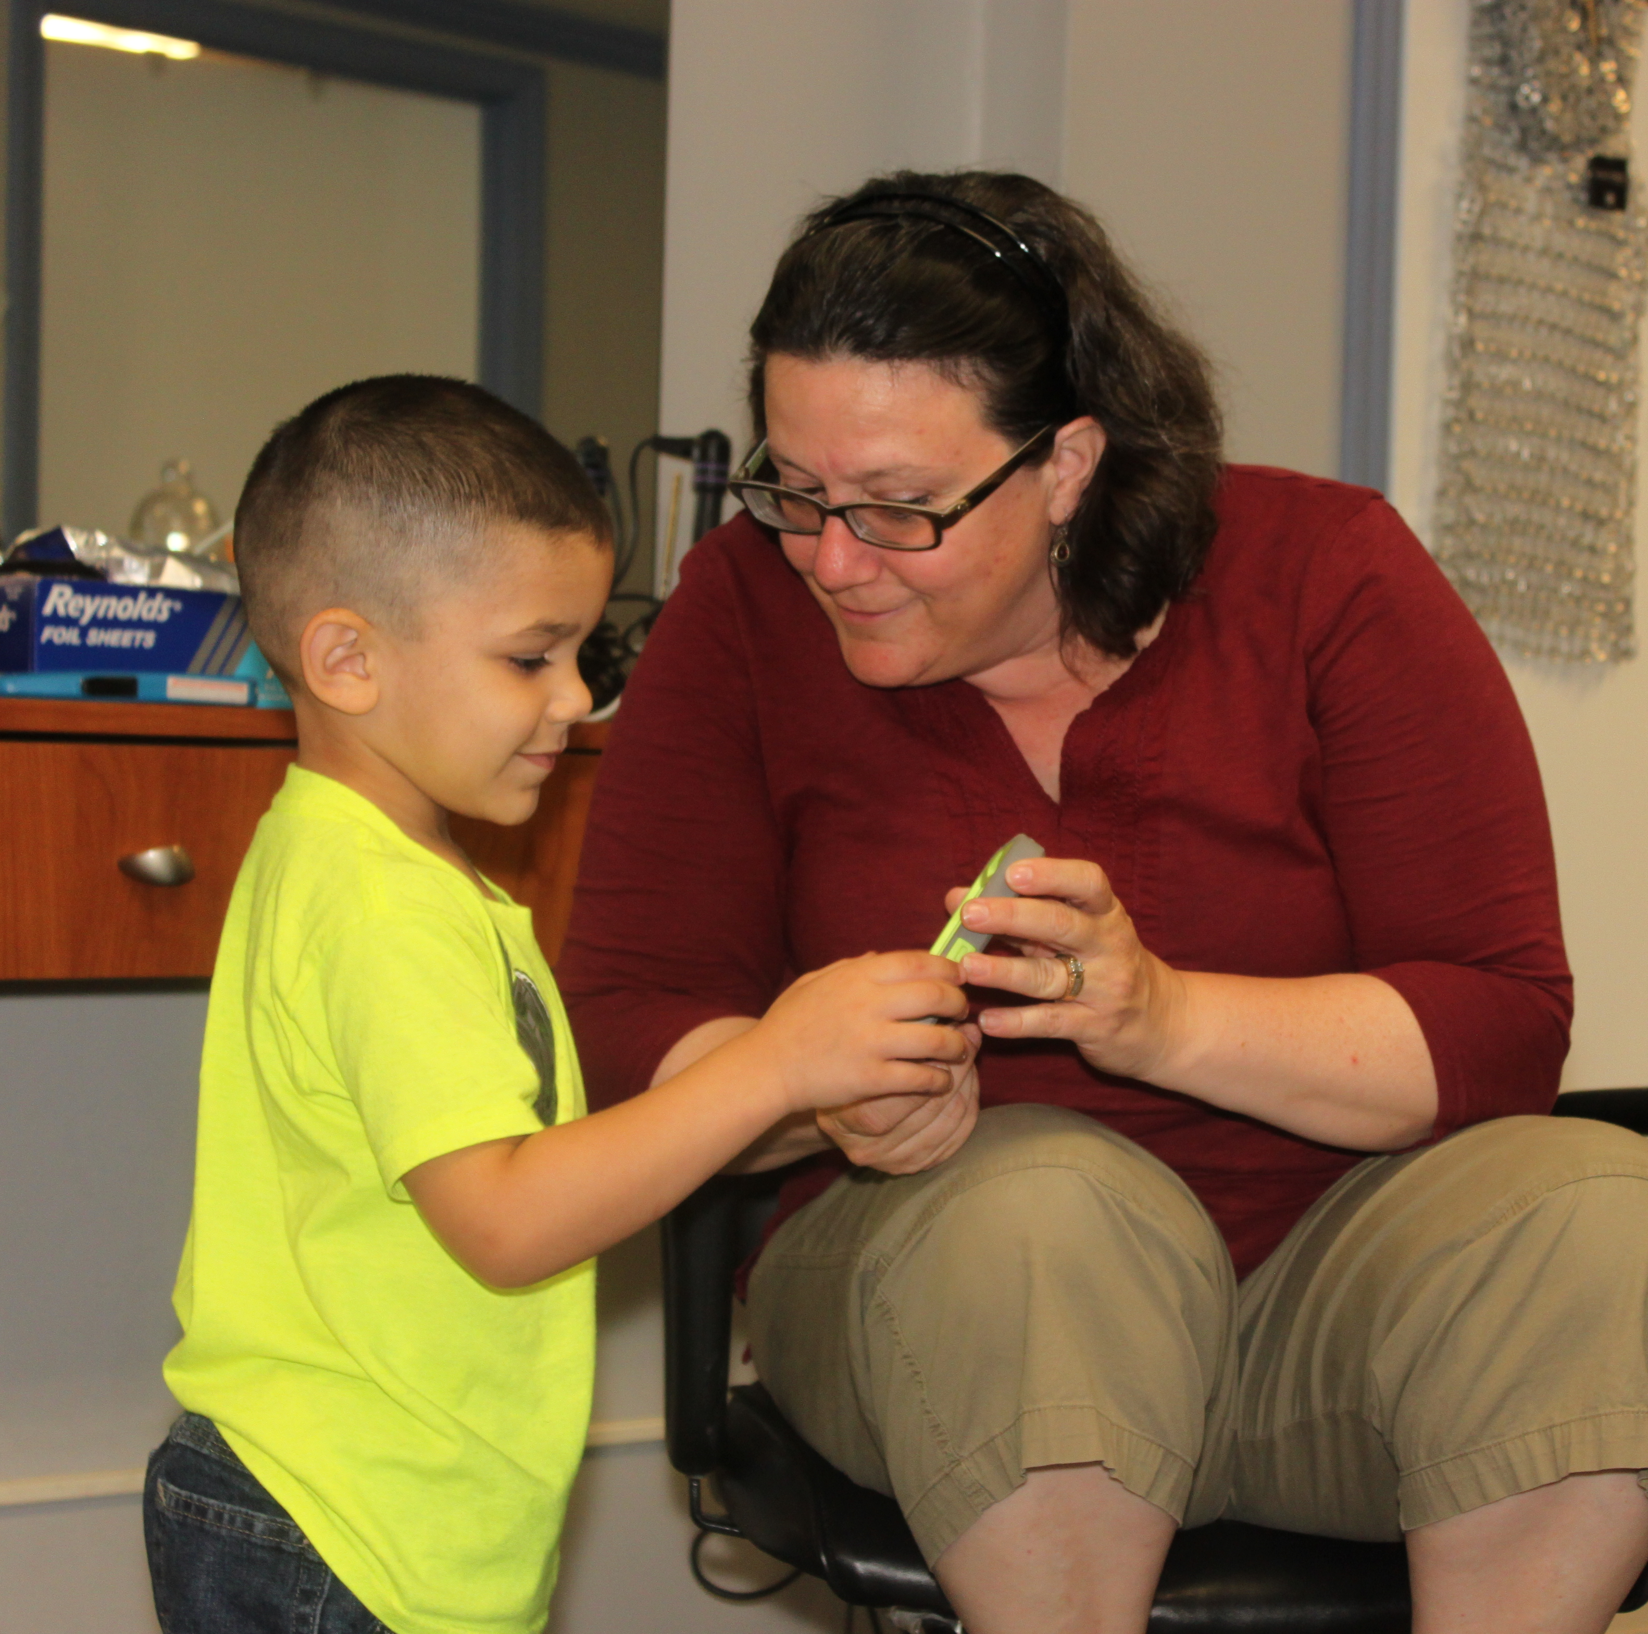
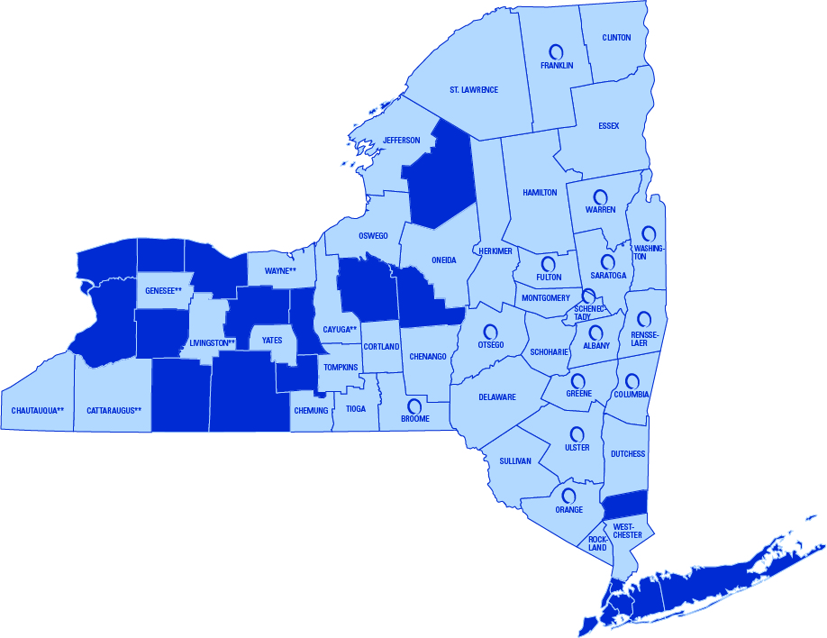
Three affiliates:
  Parsons Child and Family Center
  Northeast Parent & Child Society
  Unlimited Potential
18,000 children, adults, and families helped annually
1,400 staff
Four divisions:
  Residential and Foster Care
  Special Education
  Coordinated Care and Community Solutions
  Behavioral Health

Slide 3
Northeast Parent & Child Society
Established 1888
Parsons Child & Family Center
Established 1829
Unlimited Potential
Established 1979
Affiliated on July 1, 2012
Affiliated on July 1, 2019

Slide 4

Client Services Division
A workforce of 1,400-strong
programs and services across member agencies.
60

Slide 5
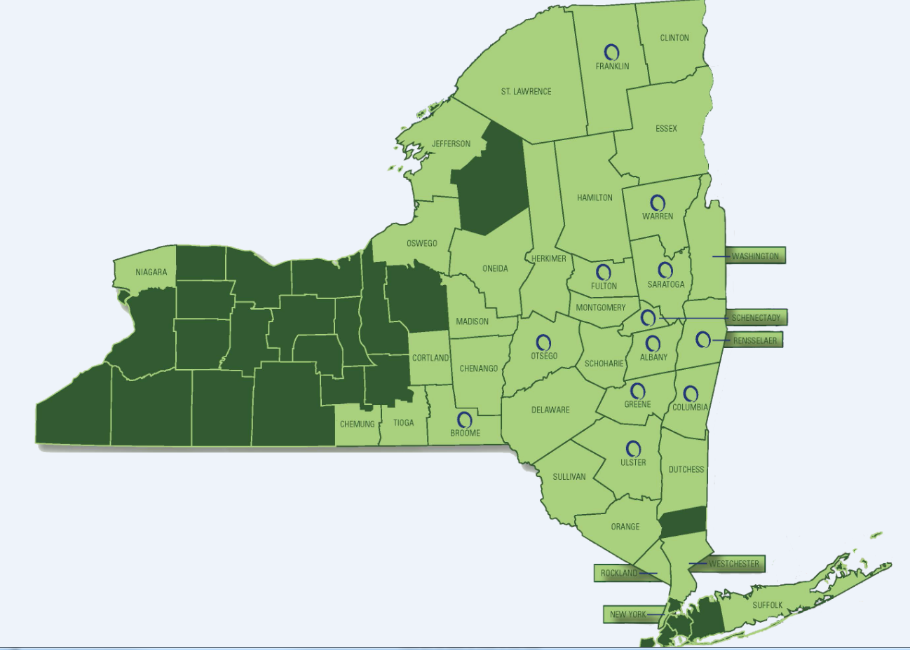
Our locations

Slide 6

Unlimited Potential
The newest of the member agencies of Northern Rivers
Based in Saratoga Springs, N.Y.
Serving individuals with Serious Emotional Disturbances
Emphasis on prevocational and employment services, peer supports, and social determinants of health

Slide 7

Unlimited Potential Programming
Three Avenues for Intervention:
  Saratoga County Mental Health
  ACCES VR
  Adult HCBS

Slide 8
Saratoga County Mental Health - Prevocational and Employment Services
What do these service entail?
  Emphasis is placed on the development of the skills needed to obtain and sustain employment.
Who is eligible?
Saratoga County residents who receive support for mental health concerns.
How is this service accessed?
  Services can be requested on behalf of a consumer by a member of their treatment team.
  An individual can self refer

Slide 9
Saratoga County Mental Health - Prevocational Services
Services components include:
• Support and guidance pertaining to :
  Work compliance
  Attendance
  Task completion
  Problem solving
  Safety
  Identifying obstacles to employment
  Obtaining paperwork necessary for employment applications
• Activities outside of an individual’s home that support acquisition, retention, or improvement in job-related skills related to self-care, sensory-motor development, daily living skills, communication, community living, improved socialization, and cognitive skills.

Slide 10
Saratoga County Mental Health – Employment Services
Services components include:
Transitional Employment Program
  Designed to strengthen the individual’s work record and work skills toward the goal of achieving assisted or unassisted competitive employment
Assistive and Competitive Employment
  Designed to prepare and support consumers for employment within an integrated setting.
Ongoing Integrated Supported Employment
  This service is provided after an individual successfully obtains and becomes oriented to competitive and integrated employment.

Slide 11
Saratoga County Mental Health - Peer Supports
What does this service entail?
  Emphasis is placed on fostering independence, self-reliance, and the development of skills needed to function in the community.
Who is eligible?
Saratoga County residents who receive support for mental health concerns.
How is this service accessed?
  Services can be requested on behalf of a consumer by a member of their treatment team.
  An individual can self refer

Slide 12
Saratoga County Mental Health – Warm Line
The Warm Line is a resource for Saratoga County mental health consumers to reach out for support in nonemergency situations which may include but are not limited to:
  Food Insecurity
  Housing Insecurity
  Social Exclusion
  Problems relating to Primary support groups
Warm Line Hours - 518.581.9809
  Tuesday, Wednesday, and Thursday, 4:00 p.m.–7:00 p.m.
  Friday and Saturday, 7:00 p.m.– 9:00 p.m.
Staffed by Peer Support Specialists

Slide 13
Saratoga County Mental Health - Golden Club
What does this service entail?
  A social group for Saratoga County seniors who receive mental health services
Who is eligible?
Saratoga County mental health consumers over the age of 50
How is this service accessed?
  Services can be requested on behalf of a consumer by a member of their treatment team.
  An individual can self refer

Slide 14
ACCES VR
What is ACCES VR?
Adult Career and Continuing Education Services-Vocational Rehabilitation (ACCES-VR) is programming offered through the NY State Department of Education that provides services to individuals who have a disability, or disabilities, that interfere with getting, keeping, or advancing in a job.
How are services accessed?
To apply or be referred for ACCES-VR services one must be:
A person with a disability or disabilities that impact their ability to get, keep or advance in a job
Currently present in New York State
Available to participate in the vocational rehabilitation process
At least 14 years old
Able to work in the United States

Slide 15
ACCES VR referral
How are these service accessed?
  Services can be applied for on behalf of a consumer by a member of their treatment team.
  An individual apply directly
  A application can be submitted by a member of the consumer’s school based services team

Slide 16
Adult Home & Community Based Services (HCBS)
What are Adult HCBS?
Services intended to provide opportunities for adult Medicaid beneficiaries with mental illness and/or substance use disorders to receive services in their own home or community.
Who is able to access these services?
Medicaid beneficiaries who are 21 years of age or older and who are enrolled in a Health and Recovery Plan (HARP) with a serious mental illness and/or substance use disorder

Slide 17
Adult HCBS referral
What is the referral process?
  HARP members will be required to be assessed for BH HCBS eligibility using the NYS Community Mental Health Eligibility Assessment.
  The NYS Eligibility Assessment will determine if an individual is eligible for BH HCBS, and if eligible, eligibility for Tier 1 or Tier 2 BH HCBS.
    Tier I services include employment, education and peer supports services.
    Tier 2 includes the full array of BH HCBS.
  If BH HCBS eligibility is determined based on the initial assessment, then a full assessment, called the NYS Community Mental Health Assessment, will be completed and a Plan of Care developed.
  Once completed, a Health Home Care Manager will work in collaboration with the individual and identify the BH HCBS that will be included in the Plan of Care.

Slide 18
Contact Information
Jennifer Myers
Director, Unlimited Potential
Phone: 518.587.2851
Email: Jennifer.Myers@northernrivers.org
Lori Favata
Executive Program Director
Phone: 518.527.4447
Email: Lori.Favata@northernrivers.org

Slide 19
